Slide 1
Topic 17 The Brayton Cycle
Thermodynamics: An Engineering Approach
8th Edition Yunus A. Çengel, Michael A. Boles
McGraw-Hill, 2015

Slide 2
Objectives
Evaluate the performance of gas power cycles for which the working fluid remains a gas throughout the entire cycle.
Develop simplifying assumptions applicable to gas power cycles.
Solve problems based on the Brayton cycle.

Slide 3
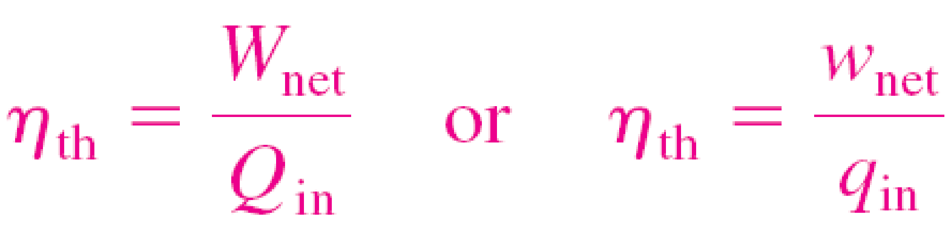
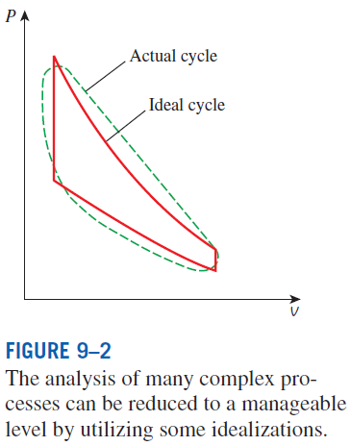
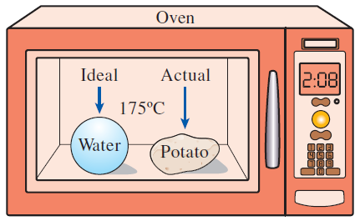
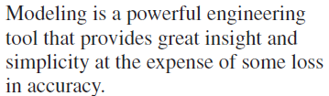
BASIC CONSIDERATIONS IN THE ANALYSIS OF POWER CYCLES
Thermal efficiency of heat engines:
Most power-producing devices operate on cycles.
Ideal cycle: A cycle that resembles the actual cycle closely but is made up totally of internally reversible processes
Reversible cycles such as Carnot cycle have the highest thermal efficiency of all heat engines operating between the same temperature levels. Unlike ideal cycles, they are totally reversible, and unsuitable as a realistic model.

Slide 4
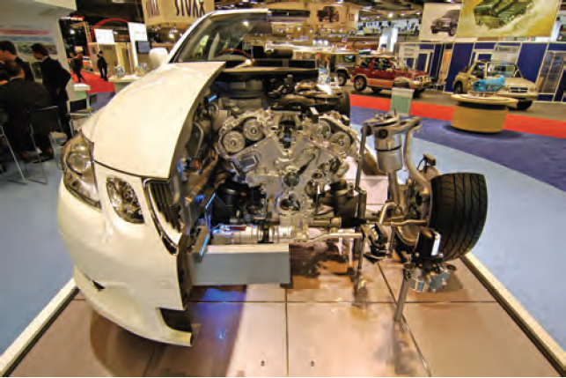
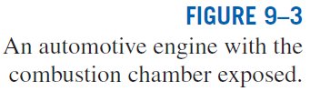
The ideal cycles are internally reversible, but, unlike the Carnot cycle, they are not necessarily externally reversible.
Therefore, the thermal efficiency of an ideal cycle, in general, is less than that of a totally reversible cycle operating between the same temperature limits.
However, it is still considerably higher than the thermal efficiency of an actual cycle because of the idealizations utilized.

Slide 5
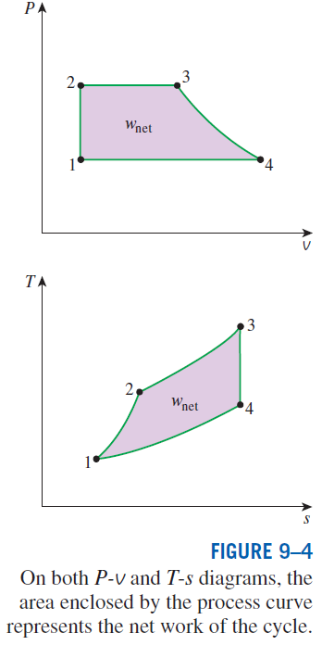
The idealizations and simplifications in the analysis of power cycles:
The cycle does not involve any friction. Therefore, the working fluid does not experience any pressure drop as it flows in pipes or devices such as heat exchangers.
All expansion and compression processes take place in a quasi-equilibrium manner.
The pipes connecting the various components of a system are well insulated, and heat transfer through them is negligible.
On a T-s diagram, the ratio of the area enclosed by the cyclic curve to the area under the heat-addition process curve represents the thermal efficiency of the cycle.
Any modification that increases the ratio of these two areas will also increase the thermal efficiency of the cycle.

Slide 6
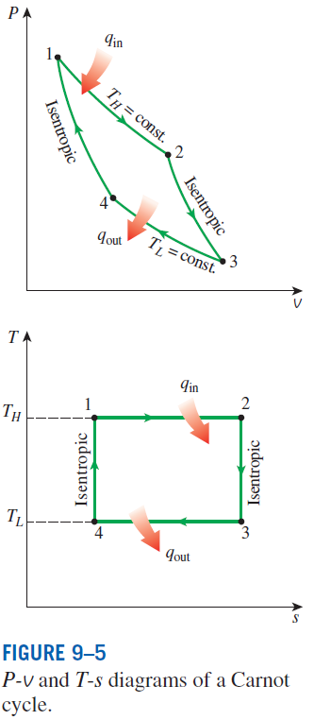

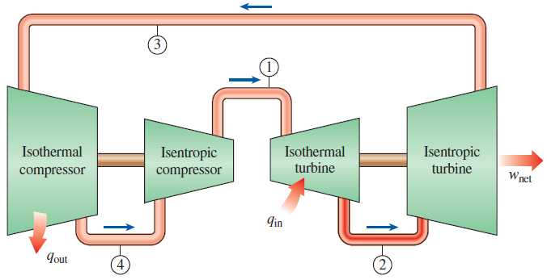
THE CARNOT CYCLE AND ITS VALUE IN ENGINEERING
The Carnot cycle is composed of four totally reversible processes: isothermal heat addition, isentropic expansion, isothermal heat rejection, and isentropic compression.
For both ideal and actual cycles: Thermal efficiency increases with an increase in the average temperature at which heat is supplied to the system or with a decrease in the average temperature at which heat is rejected from the system.
A steady-flow Carnot engine.

Slide 7


Derivation of the Efficiency of the Carnot Cycle
How was this equation derived?
Heat engine efficiency:
For an isothermal, reversible process, recall:

Slide 8

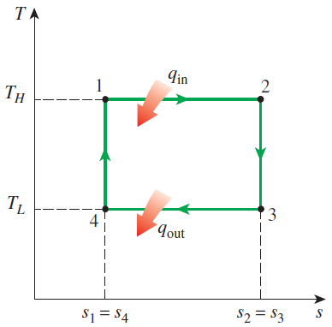

Derivation (cont.)
Recall that between the boiler and condenser, there is an adiabatic compressor (pump) and adiabatic expansion (turbine). Both are isentropic

Slide 9



Derivation (cont.)

Slide 10
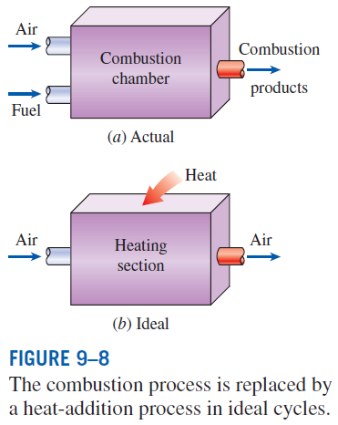
AIR-STANDARD ASSUMPTIONS
Air-standard assumptions:
The working fluid is air, which continuously circulates in a closed loop and always behaves as an ideal gas.
All the processes that make up the cycle are internally reversible.
The combustion process is replaced by a heat-addition process from an external source.
The exhaust process is replaced by a heat-rejection process that restores the working fluid to its initial state.
Cold-air-standard assumptions: When the working fluid is considered to be air with constant specific heats at room temperature (25°C).
Air-standard cycle: A cycle for which the air-standard assumptions are applicable.

Slide 11
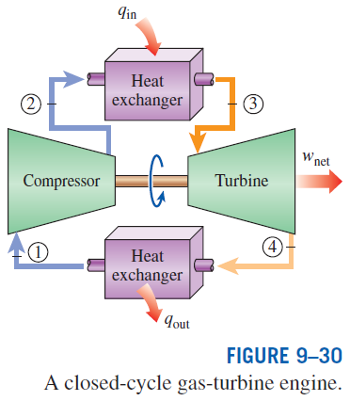
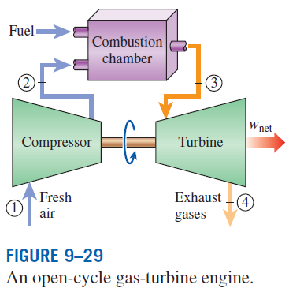
BRAYTON CYCLE: THE IDEAL CYCLE FOR GAS-TURBINE ENGINES
The combustion process is replaced by a constant-pressure heat-addition process from an external source, and the exhaust process is replaced by a constant-pressure heat-rejection process to the ambient air.
1-2 Isentropic compression (in a compressor)
2-3 Constant-pressure heat addition
3-4 Isentropic expansion (in a turbine)
4-1 Constant-pressure heat rejection

Slide 12



Efficiency of a Brayton Cycle
Recall the efficiency of a heat engine:

Slide 13
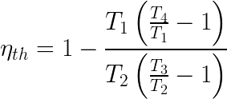




Efficiency of a Brayton Cycle
Recall for Brayton cycle:
For an isentropic, ideal gas with constant c_{p}:

Slide 14



Efficiency of a Brayton Cycle
(pressure ratio)

Slide 15
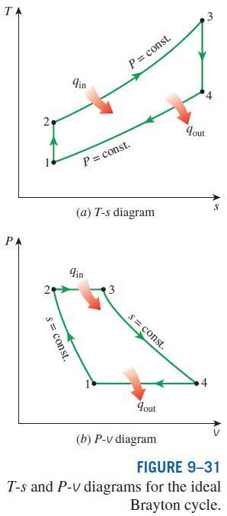
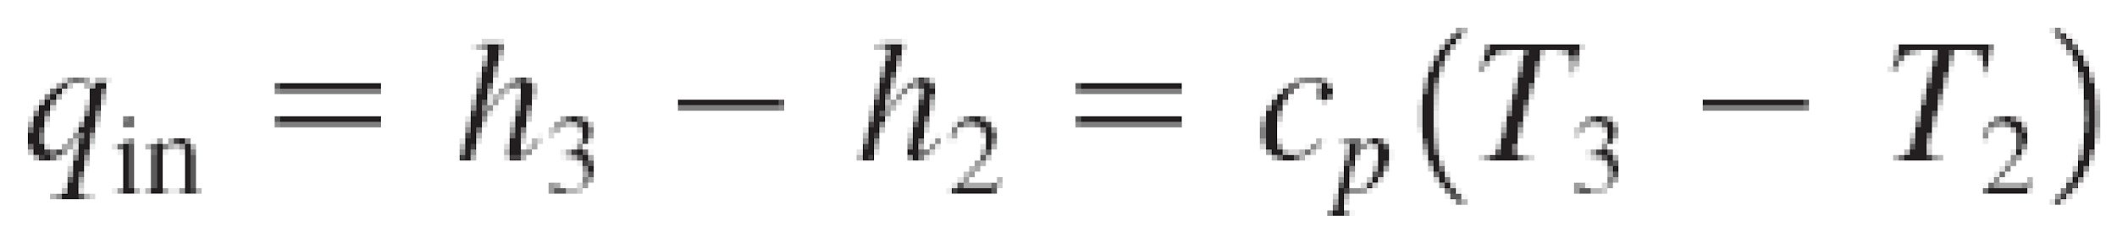

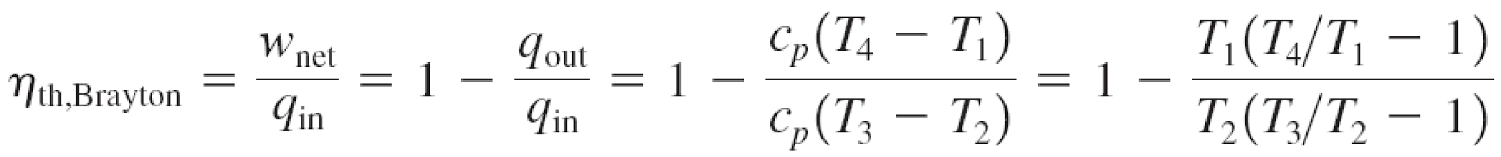
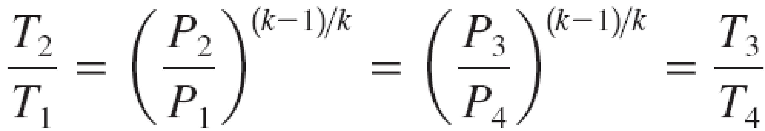

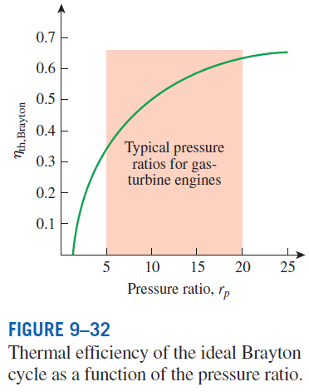

Pressure ratio

Slide 16
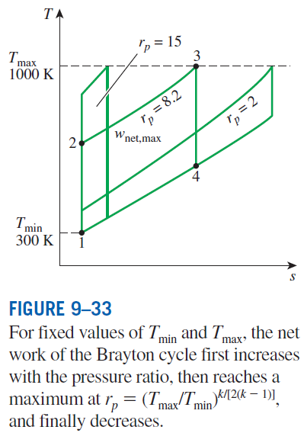
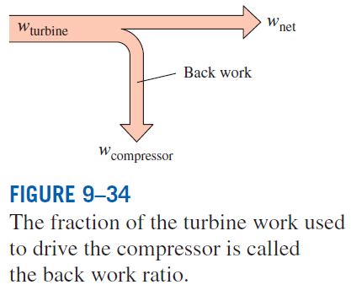
The two major application areas of gas-turbine engines are aircraft propulsion and electric power generation.
The highest temperature in the cycle is limited by the maximum temperature that the turbine blades can withstand. This also limits the pressure ratios that can be used in the cycle.
The air in gas turbines supplies the necessary oxidant for the combustion of the fuel, and it serves as a coolant to keep the temperature of various components within safe limits. An air–fuel ratio of 50 or above is not uncommon.

Slide 17
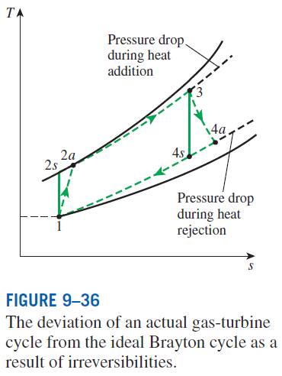
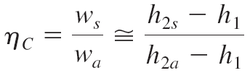
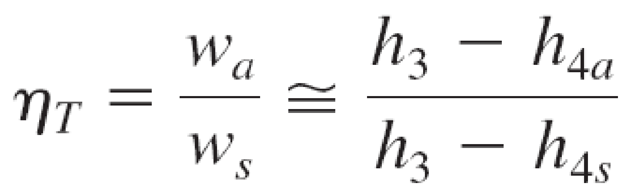
Development of Gas Turbines
Increasing the turbine inlet (or firing) temperatures
Increasing the efficiencies of turbomachinery components (turbines, compressors):
Adding modifications to the basic cycle (intercooling, regeneration or recuperation, and reheating).
Deviation of Actual Gas-Turbine Cycles from Idealized Ones
Reasons: Irreversibilities in turbine and compressors, pressure drops, heat losses
Isentropic efficiencies of the compressor and turbine

Slide 18
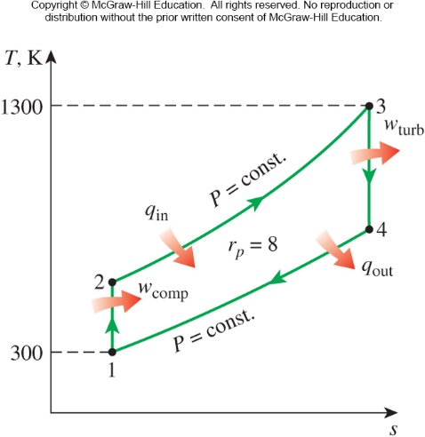
The Simple Ideal Brayton Cycle
Example 1
A gas turbine power plant operating on an ideal Brayton cycle has a pressure ratio of 8. The gas temperature is 300 K at the compressor inlet and 1300 K at the turbine inlet. Utilizing the air-standard assumptions, determine (a) the gas temperature at the exits of the compressor and the turbine, (b) the back work ratio, and (c) the thermal efficiency.

Slide 19
An Actual Gas-Turbine Cycle
Example 2
Assuming a compressor efficiency of 80% and a turbine efficiency of 85%, determine the back work ratio, the thermal efficiency, and the exit temperature of the Brayton gas-turbine cycle used in the previous problem.

Slide 20
Summary
Basic considerations in the analysis of power cycles
The Carnot cycle and its value in engineering
Air-standard assumptions
Brayton cycle: The ideal cycle for gas-turbine engines

